Slide 1
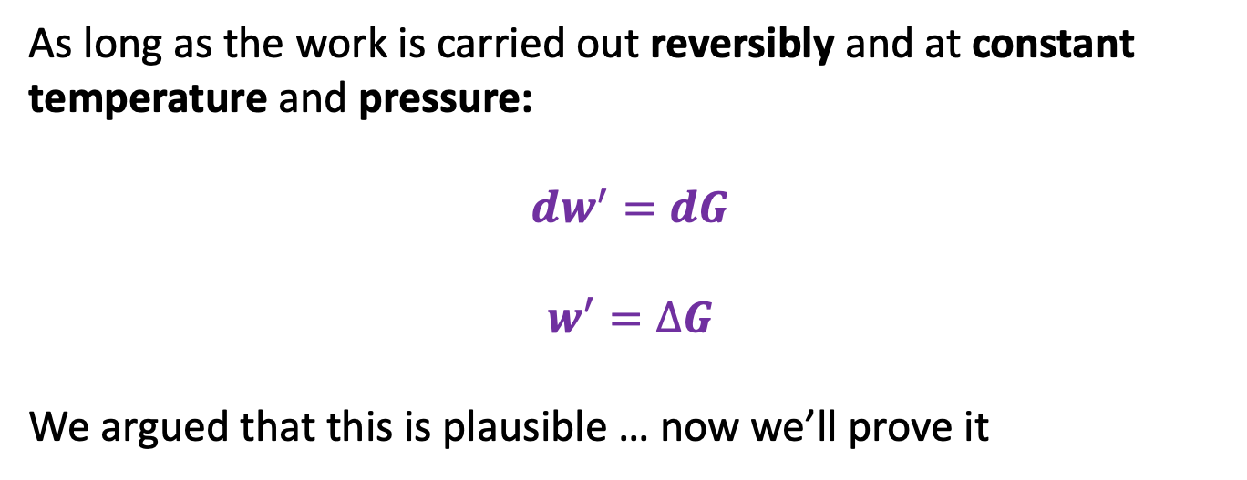
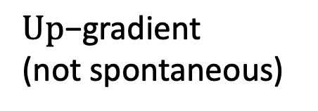
Last time: another way of thinking about the relationship between $w^{′}$and $∆G$
State “Y”
Down-gradient
(spontaneous)
$\text{U}\text{p}\text{−}\text{gradient}$
(not spontaneous)
State “X”
Higher G
As long as the work is carried out reversibly and at constant temperature and pressure:
$${dw}^{′}=dG$$
$$w^{′}=∆G$$
We argued that this is plausible … now we’ll prove it

Slide 2
A hierarchy of claims about thermodynamics
I. Easy to defend:
“Enthalpy is a state function”
“Gibbs energy is a state function”
II. A little harder to justify:
Enthalpy and Gibbs energy were invented for specific reasons.
“Enthalpy is all about heat” (according to John Hanson)
“Gibbs energy is all about work” (also according to John Hanson)
Next we’ll tackle the easy claims (I), then go after the deeper ones (II)

Slide 3
Easy to defend
Question: How do we know that Enthalpy is a state function?
Answer: …
Question: …
Answer: …

Slide 4
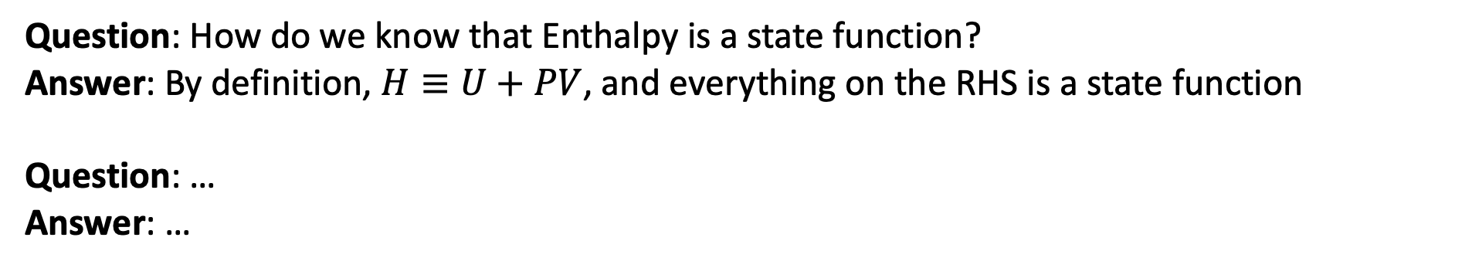
Easy to defend
Question: How do we know that Enthalpy is a state function?
Answer: By definition, $H≡U+PV$, and everything on the RHS is a state function
Question: …
Answer: …

Slide 5
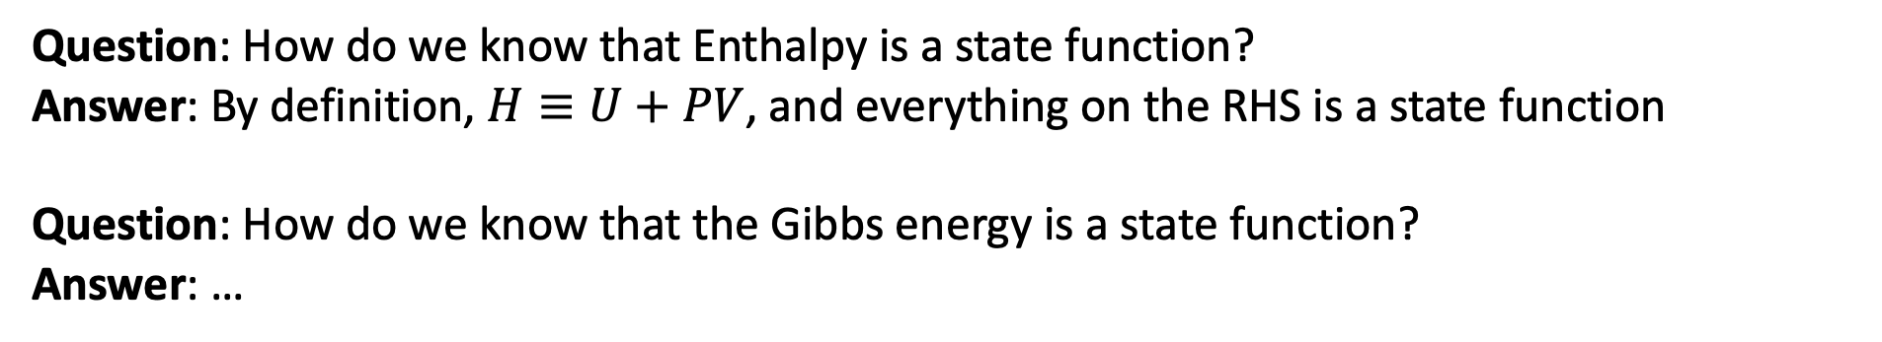
Easy to defend
Question: How do we know that Enthalpy is a state function?
Answer: By definition, $H≡U+PV$, and everything on the RHS is a state function
Question: How do we know that the Gibbs energy is a state function?
Answer: …

Slide 6
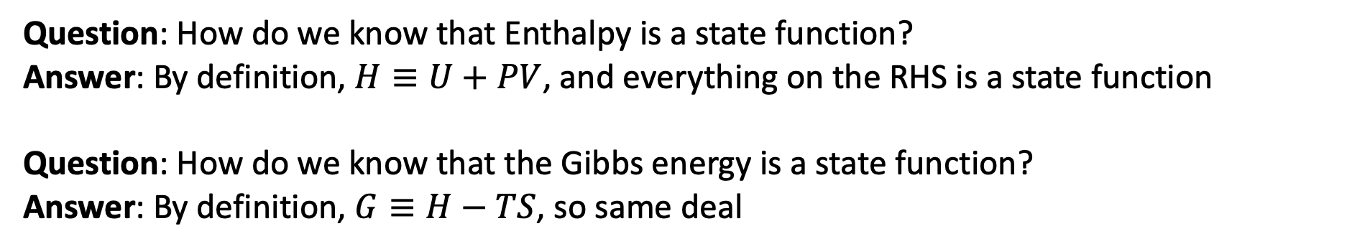
Easy to defend
Question: How do we know that Enthalpy is a state function?
Answer: By definition, $H≡U+PV$, and everything on the RHS is a state function
Question: How do we know that the Gibbs energy is a state function?
Answer: By definition, $G≡H−TS$, so same deal

Slide 7
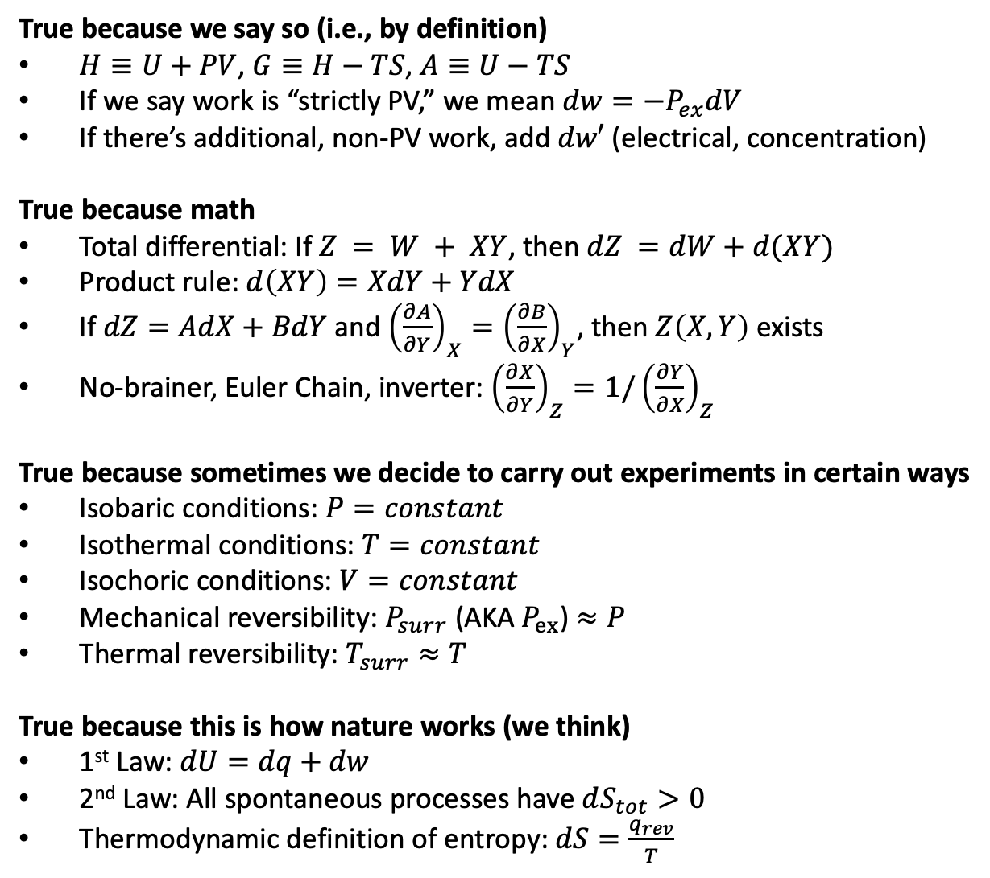
II. A little harder to justify
True because we say so (i.e., by definition)
$H≡U+PV$, $G≡H−TS$, $A≡U−TS$
If we say work is “strictly PV,” we mean $dw={−P}_{ex}dV$
If there’s additional, non-PV work, add $dw′$ (electrical, concentration)
True because math
Total differential: If $Z = W + XY$, then $dZ =dW+d(XY)$
Product rule: $d\left(XY\right)=XdY+YdX$
If $dZ=AdX+BdY$ and ${\left(\frac{∂A}{∂Y}\right)}_{X}={\left(\frac{∂B}{∂X}\right)}_{Y}$, then $Z\left(X,Y\right)$ exists
No-brainer, Euler Chain, inverter: ${\left(\frac{∂X}{∂Y}\right)}_{Z}=1/{\left(\frac{∂Y}{∂X}\right)}_{Z}$
True because sometimes we decide to carry out experiments in certain ways
Isobaric conditions: $P=constant$
Isothermal conditions: $T=constant$
Isochoric conditions: $V=constant$
Mechanical reversibility: $P_{surr}$ (AKA $P_{ex}$) $≈P$
Thermal reversibility: $T_{surr}≈T$
True because this is how nature works (we think)
1st Law: $dU=dq+dw$
2nd Law: All spontaneous processes have $dS_{tot}>0$
Thermodynamic definition of entropy: $dS=\frac{q_{rev}}{T}$
Fortunately, we have this handy arsenal of tools for addressing claims about thermodynamics that are not so self-evident.
We’ll try these out on four (related) derivations

Slide 8

Claim #1: $dH=dq$ (under certain conditions)
$$H = U+PV$$
Total differential, product rule
$$dH =…$$
$$dH =…$$
$$dH =…$$

Slide 9
Claim #1: $dH=dq$ (under certain conditions)
$$H = U+PV$$
Total differential, product rule
$$dH =dU+PdV+VdP$$
$$dH =…$$
$$dH =…$$

Slide 10
Claim #1: $dH=dq$ (under certain conditions)
$$H = U+PV$$
Total differential, product rule
$$dH =dU+PdV+VdP$$
Isobaric, 1st Law , PV work only
$$dH =…$$
$$dH =…$$

Slide 11
Claim #1: $dH=dq$ (under certain conditions)
$$H = U+PV$$
Total differential, product rule
$$dH =dU+PdV+VdP$$
Isobaric, 1st Law , PV work only
$$dH =dq−P_{ex}dV+PdV$$
$$dH =…$$

Slide 12
Claim #1: $dH=dq$ (under certain conditions)
$$H = U+PV$$
Total differential, product rule
$$dH =dU+PdV+VdP$$
Isobaric, 1st Law , PV work only
$$dH =dq−P_{ex}dV+PdV$$
Mechanical equilibrium
$$dH =…$$

Slide 13
Claim #1: $dH=dq$ (under certain conditions)
$$H = U+PV$$
Total differential, product rule
$$dH =dU+PdV+VdP$$
Isobaric, 1st Law , PV work only
$$dH =dq−P_{ex}dV+PdV$$
Mechanical equilibrium
$$dH =dq$$

Slide 14
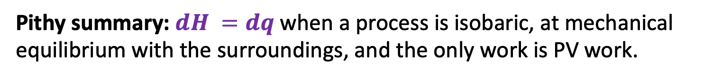

Claim #1: $dH=dq$ (under certain conditions)
$$H = U+PV$$
Total differential, product rule
$$dH =dU+PdV+VdP$$
Isobaric, 1st Law , PV work only
$$dH =dq−P_{ex}dV+PdV$$
Mechanical equilibrium
$$dH =dq$$
Pithy summary: $dH =dq$ when a process is isobaric, at mechanical equilibrium with the surroundings, and the only work is PV work.

Slide 15

Claim #2: $dH≠dq$ when there’s non-PV work (but still isobaric, etc.)
$$H = U+PV$$
Total differential, product rule
$$dH =…$$
Isobaric, 1st Law
$$dH =…$$
Mechanical equilibrium
$$dH =…$$
Pithy summary:

Slide 16

Claim #3: $dG=0$ when there’s PV work only, isobaric, isothermal, mechanically reversible
$$G =H−TS$$
Total differential, product rule, isothermal
$$dG = …$$
Isobaric, 1st Law , PV work only
$$dG = …$$
Thermodynamic definition of entropy
$$dG = …$$
Pithy summary:

Slide 17

Claim #4: $dG=dw′$ for PV+non-PV work, isobaric, isothermal, mechanically reversible
$$G =H−TS$$
Total differential, product rule, isothermal
$$dG = …$$
Isobaric, 1st Law
$$dG = …$$
Thermodynamic definition of entropy
$$dG = …$$
Pithy summary:

